Slide 1
Retail Store Sales Analysis
By Ujjawal Chaudhary

Slide 2
Introduction
I am working as a junior data analyst for FashionWave, a mid-sized retail chain with 50 stores across India. The company has been facing stagnant weekend sales, while weekday sales are consistent. Management wants to understand what drives sales, which products are performing well, and how discounting affects profitability.

Slide 3
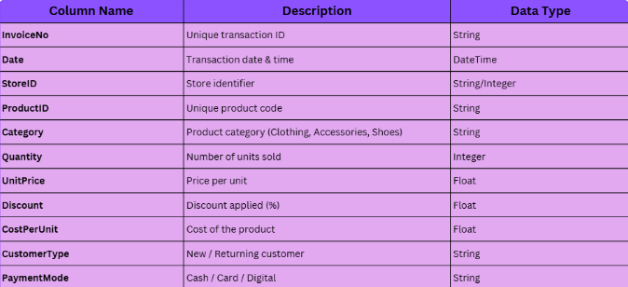
Dataset Overview

Slide 4
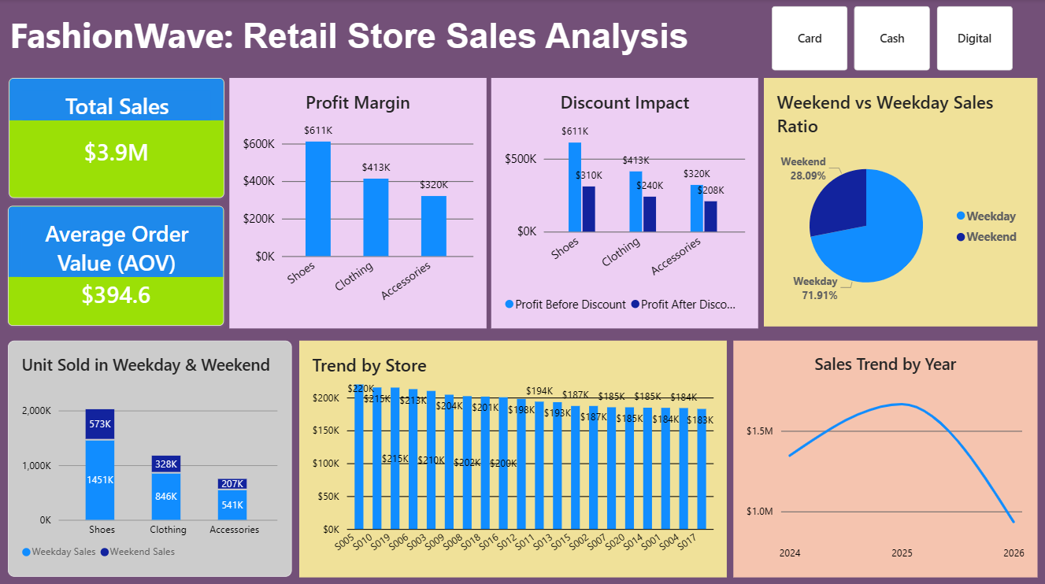
Glimpse of Dashboard

Slide 5
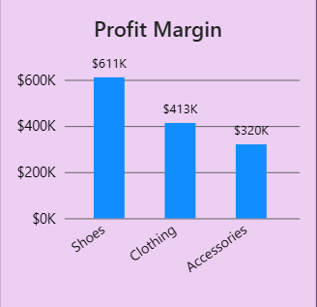
Product Categories and Profit Margin
Key Observations & Recommendations
Shoes are the strongest-performing category and contribute the largest share of overall profitability.
Accessories generate the lowest profit, indicating lower margins or weaker sales performance.
Increase marketing and inventory focus on Shoes.
Review pricing and discount strategies for Accessories to improve profitability.

Slide 6
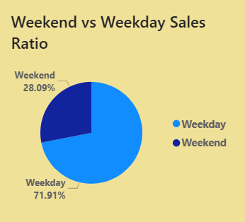
Weekend Sales VS Weekday Sales
Key Observations & Recommendations
Most customers prefer shopping on weekdays, indicating stronger weekday demand and customer activity.
Weekend sales are comparatively low and may represent an opportunity for growth.
Introduce weekend-exclusive offers or promotions to increase weekend footfall and sales.
Run targeted marketing campaigns during weekends to improve customer engagement.

Slide 7
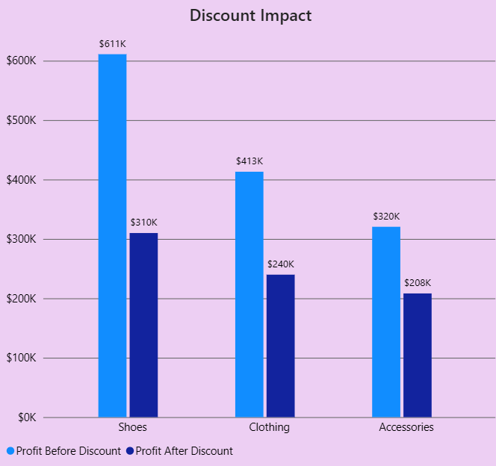
Impact Of Discounting on Profit Margins
Key Observations & Recommendations
Heavy discounts significantly reduce overall profitability.
Although discounts may help increase sales volume, excessive discounting lowers margins and business earnings.
Avoid large discounts on high-performing products like Shoes.
Apply discounts mainly to slow-moving or seasonal inventory.
Use moderate and targeted discount strategies to balance sales growth and profitability.

Slide 8
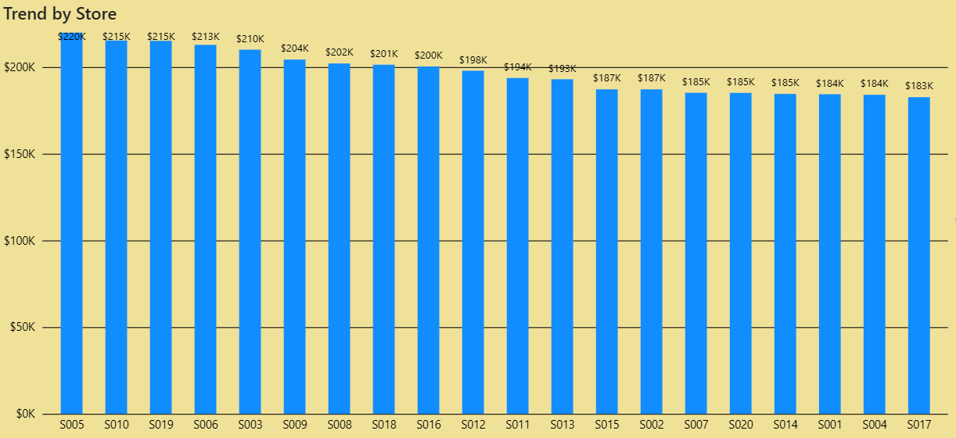
Stores Performance
Key Observations & Recommendations
Some stores generate lower sales and profit compared to top-performing stores.
Underperforming stores may have lower customer demand and weaker sales of high-profit categories.
Increase marketing activities and weekend promotions in low-performing stores.
Improve inventory planning by focusing on high-demand and high-profit products.

Slide 9
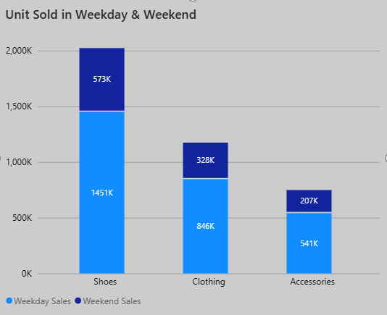
Customer Segmentation Based on Purchase Behavior
Key Observations & Recommendations
Customers respond differently to discounts and promotional offers.
Some customers appear more price-sensitive, as sales increase during discount periods.
Use targeted promotional campaigns for discount-sensitive customers.
Introduce personalized offers and loyalty programs to improve customer retention and repeat purchases.

Slide 10
Strategic Recommendation
Quick Wins
Introduce weekend-exclusive offers to improve weekend sales performance.
Focus marketing and inventory on high-performing categories like Shoes.
Reduce excessive discounts on products already generating strong profits.
Long-Term Strategies
Improve underperforming stores using location- based promotions and better inventory planning.
Use customer behavior insights to create personalized marketing campaigns.
Build loyalty programs to increase customer retention and repeat purchases.

Slide 11
Thank You
Prepared by: Ujjawal Chaudhary

